Slide 1
R.K.Tiwary

Slide 2
CONTROL UNIT OPERATION
The execution of an instruction involves the execution of a sequence of substeps, generally called cycles
The Fetch Cycle
The Indirect Cycle
The Interrupt Cycle
The Execute Cycle
The Instruction Cycle
control unit of a processor performs two tasks:
step through a series of micro-operations in the proper sequence
generates the control signals

Slide 3
CONTROL UNIT OPERATION
The control signals generated by the control unit cause the opening and closing of logic gates, resulting in the transfer of data to and from registers and the operation of the ALU
technique for implementing a control unit
hardwired implementation
Microprogrammed control
Micro-operations are a sequence of more fundamental operations which constitute the operation cycle.
A single micro-operation generally involves a transfer between registers, a transfer between a register and an external bus, or a simple ALU operation

Slide 4
Micro-Operations
A computer executes a program
Fetch/execute cycle
Each cycle has a number of steps : Called micro-operations
Each step does very little: Atomic operation of CPU
micro-operations needed to perform the subcycles of the instruction cycle.

Slide 5
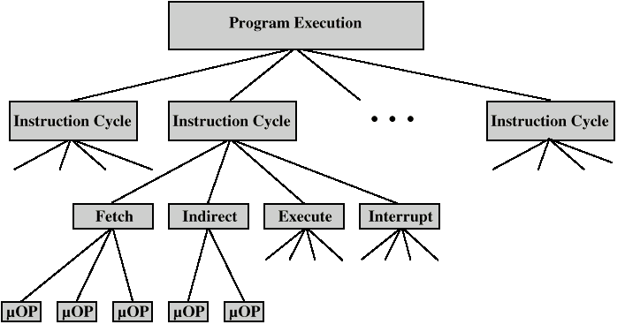

Constituent Elements of Program Execution

Slide 6
The Fetch Cycle
Memory Address Register (MAR)
Connected to address bus
Specifies address for read or write op
Memory Buffer Register (MBR)
Connected to data bus
Holds data to write or last data read
Program Counter (PC)
Holds address of next instruction to be fetched
Instruction Register (IR)
Holds last instruction fetched

Slide 7
Executing an Instruction
Fetch the contents of the memory location pointed to by the PC. The contents of this location are loaded into the IR (fetch phase).
IR ← [[PC]]
Assuming that the memory is byte addressable, increment the contents of the PC by 4 (Assume 4 Byte instruction).
PC ← [PC] + 4
Carry out the actions specified by the instruction in the IR (execution phase).

Slide 8
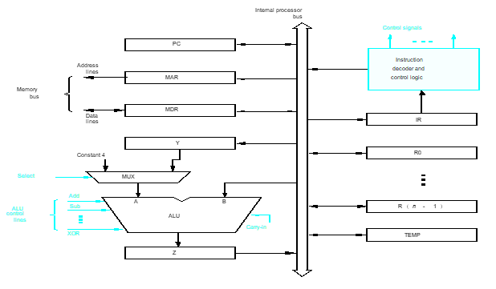
Processor Organization

Slide 9
Internal organization of the processor
ALU
Registers for temporary storage
Various digital circuits for executing different micro
operations.(gates, MUX,decoders,counters).
Internal path for movement of data between ALU and registers.
Driver circuits for transmitting signals to external units.
Receiver circuits for incoming signals from external units.

Slide 10
PC:
Keeps track of execution of a program
Contains the memory address of the next instruction to be fetched and executed.
MAR:
Holds the address of the location to be accessed.
I/P of MAR is connected to Internal bus and an O/p to external bus.
MDR:
Contains data to be written into or read out of the addressed location.
IT has 2 inputs and 2 Outputs.
Data can be loaded into MDR either from memory bus or from internal processor bus.
The data and address lines are connected to the internal bus via MDR and MAR

Slide 11
Registers:
The processor registers R₀ to R_{n-1} vary considerably from one processor to another.
Registers are provided for general purpose used by programmer.
Special purpose registers-index & stack registers.
Registers Y,Z &TEMP are temporary registers :used by processor during the execution of some instruction.
Multiplexer:
Select either the output of the register Y or a constant value 4 to be provided as input A of the ALU.
Constant 4 is used by the processor to increment the contents of PC.

Slide 12
ALU:
Used to perform arithmetic and logical operation.
Data Path:
The registers, ALU and interconnecting bus are collectively referred to as the data path.

Slide 13
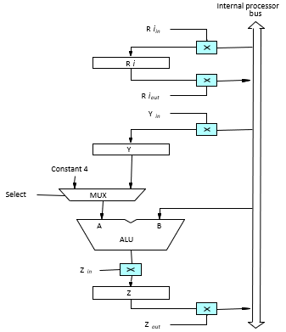
Register Transfers
The input and output gates for register R_{i} are controlled by signals in R_{in} and R_{iout .}
R_{in} Is set to1 – data available on common bus are loaded into R_{i}.
R_{iout} Is set to1 – the contents of register are placed on the bus.
R_{iout} Is set to 0 – the bus can be used for transferring data from other registers .

Slide 14
Data transfer between two registers:
EX:
Transfer the contents of R1 to R4.
Enable output of register R₁ by setting R_{1out}=1. This places the contents of R₁ on the processor bus.
Enable input of register R₄ by setting R_{4in}=1. This loads the data from the processor bus into register R₄.

Slide 15
Fetch Sequence (symbolic)
t1: MAR <- (PC)
t2: MBR <- (memory)
PC <- (PC) +n
t3: IR <- (MBR)
(tx = time unit/clock cycle)
or
t1: MAR <- (PC)
t2: MBR <- (memory)
t3: PC <- (PC) +n
IR <- (MBR)
Assume n byte instruction

Slide 16

Rules for Clock Cycle Grouping
Proper sequence must be followed
MAR <- (PC) must precede MBR <- (memory)
Conflicts must be avoided
Must not read & write same register at same time
MBR <- (memory) & IR <- (MBR) must not be in same cycle
Also: PC <- (PC) +n involves addition
Use ALU
May need additional micro-operations

Slide 17
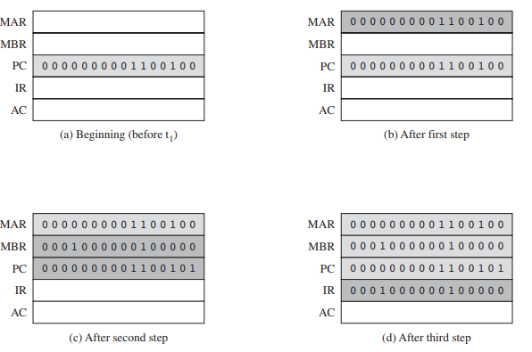
Sequence of Events, Fetch Cycle

Slide 18
Interrupt Cycle
t1: MBR <-(PC)
t2: MAR <- save-address
PC <- routine-address
t3: memory <- (MBR)
This is a minimum
May be additional micro-ops to get addresses
N.B. saving context is done by interrupt handler routine, not micro-ops

Slide 19
The Execute Cycle
Different for each instruction
e.g. ADD R1,X - add the contents of location X to Register 1 , result in R1
t1: MAR <- (IR_{address})
t2: MBR <- (memory)
t3: R1 <- R1 + (MBR)
Note no overlap of micro-operations

Slide 20
Performing an Arithmetic or Logic Operation
The ALU is a combinational circuit that has no internal storage.
ALU gets the two operands from MUX and bus. The result is temporarily stored in register Z.
What is the sequence of operations to add the contents of register R₁ to those of R₂ and store the result in R₃?
R_{1out}, Y_{in}
R_{2out}, SelectY, Add, Z_{in}
Z_{out}, R_{3in}
R₃= R₁+R₂

Slide 21
Performing an Arithmetic or Logic Operation
Step 1: Output of the register R1 and input of the register Y are enabled, causing the contents of R1 to be transferred to Y.
Step 2: The multiplexer’s select signal is set to select Y causing the multiplexer to gate the contents of register Y to input A of the ALU. At the same time contents of R2 are gated into the bus and hence to input B
Step 3: The contents of Z are transferred to the destination register R3.
R₃= R₁+R₂

Slide 22
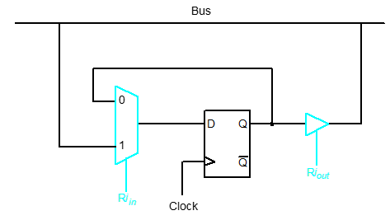
Register Transfers
Input and output gating for one register bit.
Rin | clk | Q
0 |  | Q
1 |  | B
I_{o}
_{Q}
B
When R_{out}=1 B=Q. otherwise in high impedance state

Slide 23
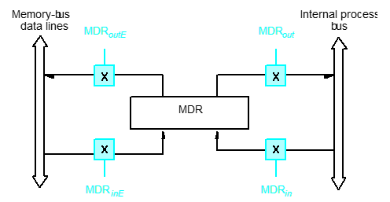
Fetching a Word from Memory
. Connection and control signals for register MDR

Slide 24
Instruction Cycle
Each phase decomposed into sequence of elementary micro-operations
E.g. fetch, indirect, and interrupt cycles Execute cycle
One sequence of micro-operations for each opcode
Assume new 2-bit register called ICC
Instruction cycle code (ICC) designates which part of cycle processor is in
00: Fetch
01: Indirect
10: Execute
11: Interrupt

Slide 25
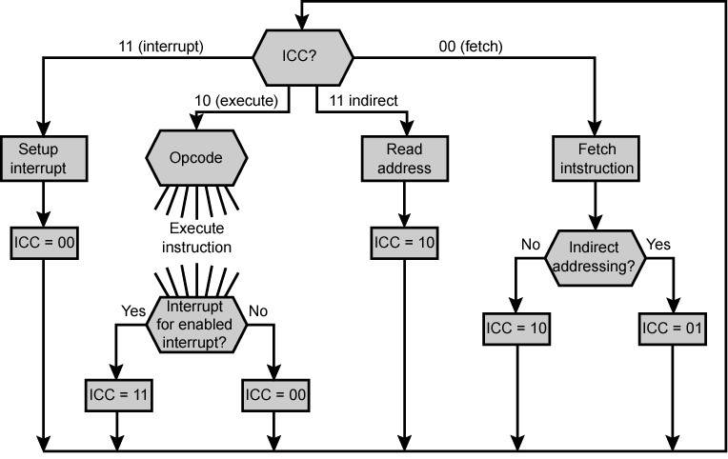
Flowchart for Instruction Cycle

Slide 26
Requirements for CONTROL OF THE PROCESSOR
the following three-step process leads to a characterization of the control unit
Define the basic elements of the processor.
Describe the micro-operations that the processor performs.
Determine the functions that the control unit must perform to cause the micro-operations to be performed
The control unit performs two basic tasks:
• Sequencing: The control unit causes the processor to step through a series of micro-operations in the proper sequence, based on the program being executed.
• Execution: The control unit causes each micro-operation to be performed

Slide 27
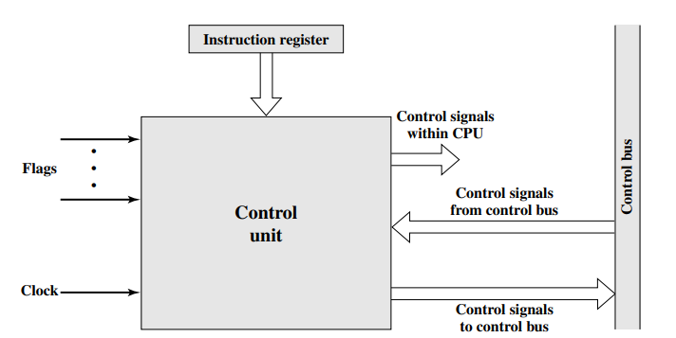
Control Unit
Clock
One micro-instruction (or set of parallel micro-instructions) per clock cycle
Instruction register
Op-code for current instruction
Determines which micro-instructions are performed
Flags
State of CPU
Results of previous operations
From control bus
Interrupts
Acknowledgements
Block Diagram of the Control Unit

Slide 28

Example Control Signal Sequence - Fetch
MAR <- (PC)
Control unit activates signal to open gates between PC and MAR
MBR <- (memory)
Open gates between MAR and address bus
Memory read control signal
Open gates between data bus and MBR

Slide 29
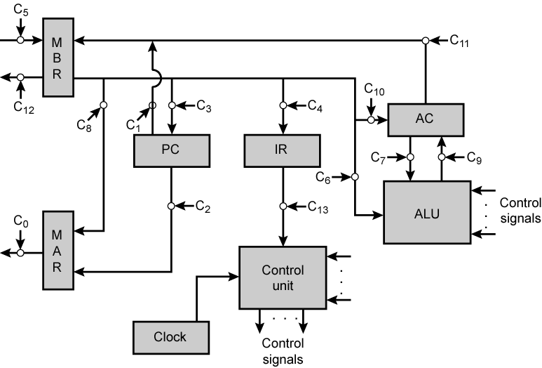
Data Paths and Control Signals

Slide 30
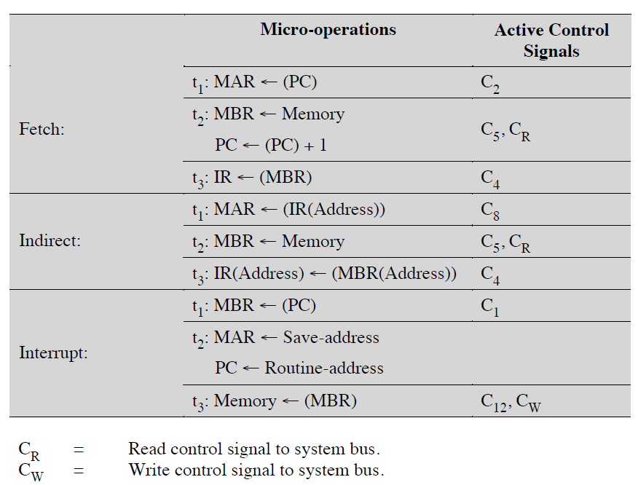

Slide 31
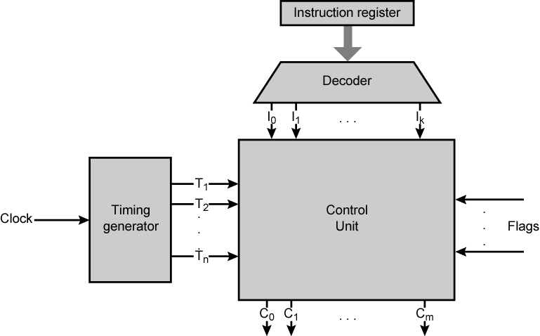

Control Unit with Decoded Inputs

Slide 32

Hardwired control Signal
Let us consider a single control signal, C5. This signal causes data to be read from the external data bus into the MBR
PQ = 11 Instruction C; PQ = 10 EC ;PQ = 01 Indirect Cycle; PQ = 00 FC
Then the following Boolean expression defines C5
This expression is not complete. C5 is also needed during the execute cycle. For our simple example, let us assume that there are only three instructions that read from memory: LDA, ADD, and AND. Now we can define C5
This same process could be repeated for every control signal generated by the processor

Slide 33
Hardwired Implementation (1)
Control unit inputs
Flags and control bus
Each bit means something
Instruction register
Op-code causes different control signals for each different instruction
Unique logic for each op-code
Decoder takes encoded input and produces single output
n binary inputs and 2^{n} outputs

Slide 34
Hardwired Implementation (2)
Clock
Repetitive sequence of pulses
Useful for measuring duration of micro-ops
Must be long enough to allow signal propagation
Different control signals at different times within instruction cycle
Need a counter with different control signals for t1, t2 etc.

Slide 35
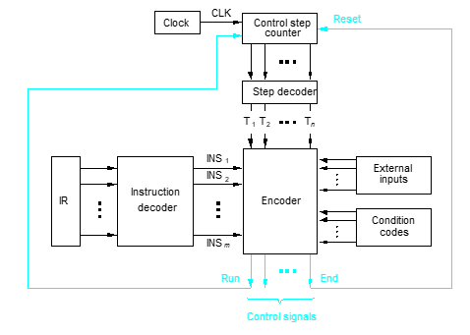
Detailed Block Description

Slide 36
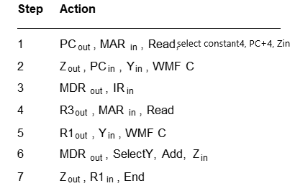
Generating Z_{in}
Control sequence for an unconditional branch instruction
Step
Action
Add (R3), R1
1
PC
out
,
MAR
in
,
Read,
Select4,
Add,
Z
in
2
Z
out
,
PC
in
,
Y
in
,
WMF
C
3
MDR
out
,
IR
in
4
Offset-field-of-IR
out
,
Add,
Z
in
5
Z
out
,
PC
in
,
End

Slide 37
Generating Z_{in}
Branch
Add
T
4
T
6
T
1
Z_{in} = T₁ + T₆ • ADD + T₄ • BR + …

Slide 38
Problems With Hard Wired Designs
Complex sequencing & micro-operation logic
Difficult to design and test
Inflexible design
Difficult to add new instructions

Slide 39
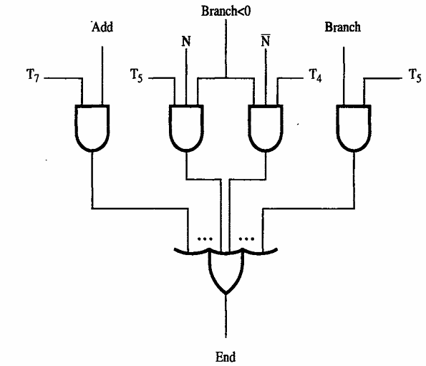
Generating End
End = T₇ • ADD + T₅ • BR + (T₅ • N + T₄ • N) • BRN +…
Control Step counter to its starting value

Slide 40
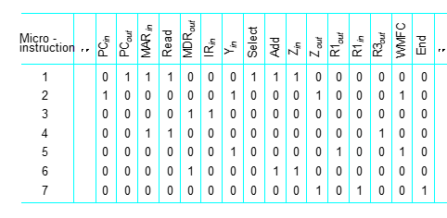
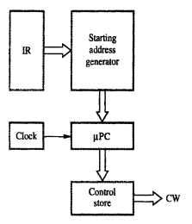
Microprogrammed Control
Control signals are generated by a program similar to machine language programs.
Control Word (CW); Microroutine; individual microinstruction
Add R1,(R3)

Slide 41
Micro-programmed Control Implementation
Use sequences of instructions to control complex operations Called micro-programming or firmware
All the control unit does is generate a set of control signals
Each control signal is on or off
Represent each control signal by a bit
Have a control word for each micro-operation
Have a sequence of control words for each machine code instruction
Add an address to specify the next micro-instruction, depending on conditions

Slide 42
Micro-programmed Control Implementation
Today’s large microprocessor
Many instructions and associated register-level hardware
Many control points to be manipulated
This results in control memory that
Contains a large number of words
corresponding to the number of instructions to be executed
Has a wide word width
Due to the large number of control points to be manipulated

Slide 43
Micro-program
Word Length Based on 3 factors
Maximum number of simultaneous micro-operations supported
The way control information is represented or encoded
The way in which the next micro-instruction address is specified
Types
Each micro-instruction specifies single (or few) micro-operations to be performed
(vertical micro-programming)
Each micro-instruction specifies many different micro-operations to be performed in parallel
(horizontal micro-programming)

Slide 44
Micro-program
Vertical Micro-programming
Width is narrow
n control signals encoded into log₂ n bits
Limited ability to express parallelism
Considerable encoding of control information requires external memory word decoder to identify the exact control line being manipulated
Horizontal Micro-programming
Wide memory word
High degree of parallel operations possible
Little encoding of control information

Slide 45
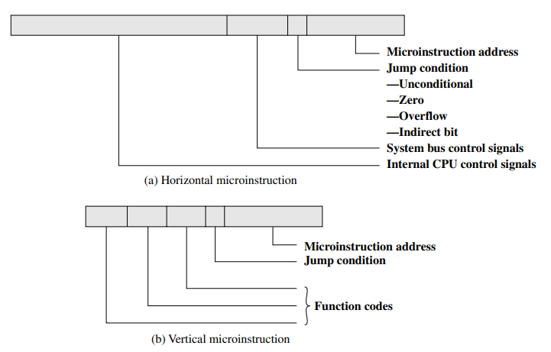
Typical Microinstruction Formats

Slide 46
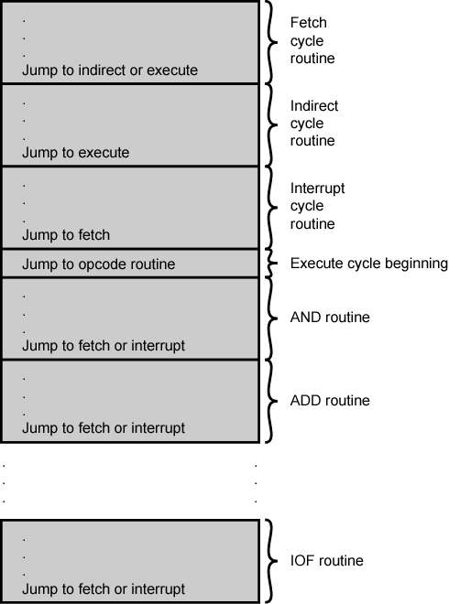
Micro-program Organization ofControl Memory
Compromise
Divide control signals into disjoint groups
Implement each group as separate field in memory word
Supports reasonable levels of parallelism without too much complexity

Slide 47
Execution of a Complete Instruction (self study)
Add R1, (R3)
Fetch the instruction
Fetch the first operand (the contents of the memory location pointed to by R3)
Perform the addition
Load the result into R1

Slide 48
Execution of a Complete Instruction
Add R1, (R3)

Slide 49
Data Flow, Fetch Cycle
Add R1, (R3)
WMFC: Wait for memory function check to accommodate the variability in response time, The addressed device sets this signal to 1 to indicate that contents of the specified location has been read

Slide 50
Example
Write the sequence of control steps needed to add the immediate number to R1 as per the bus structure shown

Slide 51
Example
PC_{out}, MAR_{in}, Read, Select4, Add, Z_{in}
Z_{out}, PC_{in}, Y_{in}, WMFC
MDR_{out}, IR_{in}
P_{Cout}, MAR_{in}, Read, Select4, Add, Z_{in}
Z_{out}, PC_{in}, Y_{in}
R1_{out}, Y_{in}, WMFC
MDR_{out}, SelectY, Add, Z_{in}
Z_{out}, R1_{in}, End

Slide 52
Execute Cycle (ISZ)
ISZ X - increment and skip if zero
The content of location X is incremented by 1. If the result is 0, the next instruction is skipped. A possible sequence of micro-operations is
t1: MAR <- (IR_{address})
t2: MBR <- (memory)
t3: MBR <- (MBR) + 1
t4: memory <- (MBR)
if (MBR) == 0 then PC <- (PC) + 1
Notes:
if is a single micro-operation
Micro-operations done during t4

Slide 53
Execute Cycle (BSA)
BSA X - Branch and save address
Address of instruction following BSA is saved in X
Execution continues from X+1
t1: MAR <- (IR_{address})
MBR <- (PC)
t2: PC <- (IR_{address})
memory <- (MBR)
t3: PC <- (PC) + 1
The address in the PC at the start of the instruction is the address of the next instruction in sequence. This is saved at the address designated in the IR. The latter address is also incremented to provide the address of the instruction for the next instruction cycle

Slide 54
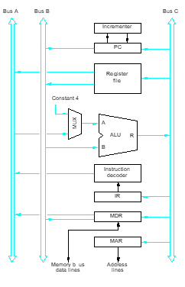
Multiple-Bus Organization
Allow the contents of two different registers to be accessed simultaneously and have their contents placed on buses A and B.
Allow the data on bus C to be loaded into a third register during the same clock cycle.
Incrementer unit.
ALU simply passes one of its two input operands unmodified to bus C
→ control signal: R=A or R=B

Slide 55
Add R6, R4, R5
Step
Action
1
PC
out
,
R=B,
MAR
in
,
Read,
IncPC
2
WMF
C
3
MDR
outB
,
R=B,
IR
in
4
R4
outA
,
R5
outB
,
SelectA,
Add,
R6
in
,
End

